Slide 1
introduction to screening,
brief intervention, and
referral to treatment (SBIRT)
Stephen Strobbe, PhD, RN, NP, PMHCNS-BC, CARN-AP
2015 Opiate Conference
Doubletree Hotel, Bay City, MI
Friday, November 20, 2015

Slide 2
contact information
Dr. Stephen Strobbe
Clinical Associate Professor
University of Michigan School of Nursing
University of Michigan Department of Psychiatry
President-Elect
International Nurses Society on Addictions (IntNSA)
www.intnsa.org
Address: 400 North Ingalls, Room 2349
Ann Arbor, MI 48109
E-mail: strobbe@umich.edu
Phone: (734) 647-0463
Fax: (734) 936-5525

Slide 3
outline (part 1 of 2)
thank you (Bay City and me)
resources
the big picture
conceptual models of addiction
a more focused view: tobacco, alcohol, cannabis, and prescription opioids
recommendations for prevention and screening: USPSTF and others
BREAK (when it makes sense)

Slide 4
outline (part 2 of 2)
SBIRT
screening
brief intervention
referral to treatment
other considerations
mutual help groups
medications
pain management
current practice
impact of changes within health care
summary, questions, answers, discussion

Slide 5
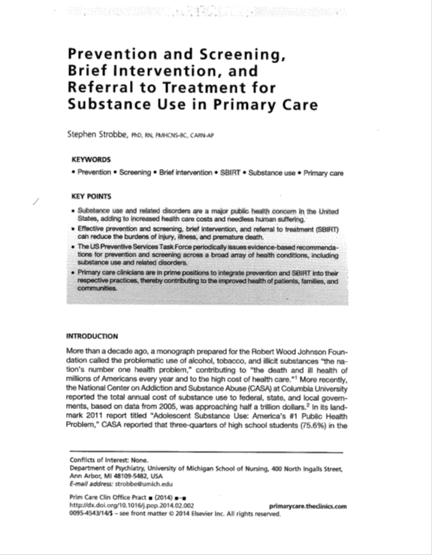
two articles, one message

Slide 6
“the nation’s number one health problem”
2001: “Substance abuse…the problematic use of alcohol, tobacco, and illicit substances…the nation’s number one health problem.”
2009: Based on data from 2005, CASA reports total annual costs of substance use at nearly half a trillion dollars.
2011: “Adolescent Substance Use: America’s #1 Public Health Problem.”
Report by the Executive Office of the President of the United States (2011), nonmedical use of prescription medications “the nation’s fastest-growing drug problem.”

Slide 7
morbidity and mortality
Of the more than two million
deaths each year in the
United States, approximately
one in four is attributable to
alcohol, tobacco, illicit drug
use.
Tobacco 440,000
Alcohol 110,000
Prescriptions 20,000
Other Illlicits 16,000

Slide 8
the human element
One in four children in the U.S. (about 18 million, or 28.6 percent) is exposed to alcohol abuse or dependence in their families before the age of 18 (Grant, 2000).
More than half of all adults (98 million, or 52.9%) have an alcoholic family member (Dawson & Grant, 1998).

Slide 9
self-reflection
“Given these statistics, it is perfectly understandable—perhaps even predictable—that a great many people…might have strong personal feelings about addictions. In order to provide optimal care, it is important…to first examine [our] own attitudes, beliefs, and potential biases regarding the treatment of patients with possible substance use disorders.”
www.curtnerart.com

Slide 10
conceptual models of addiction
these models are not mutually exclusive
they may overlap
individuals may subscribe to aspects of more than one model
will influence the ways that you practice

Slide 11
moral or criminal model
addiction as personal weakness, lack of character or willpower, disregard for social norms
overtones may be religious, legal, social, political, or racial
use of substances considered volitional, i.e., solely a matter of personal choice, with responsibility for related consequences resting solely with the individual
scorn, isolation, or punishment may be harshly imposed, with an eye toward repentance, retribution, or rehabilitation

Slide 12
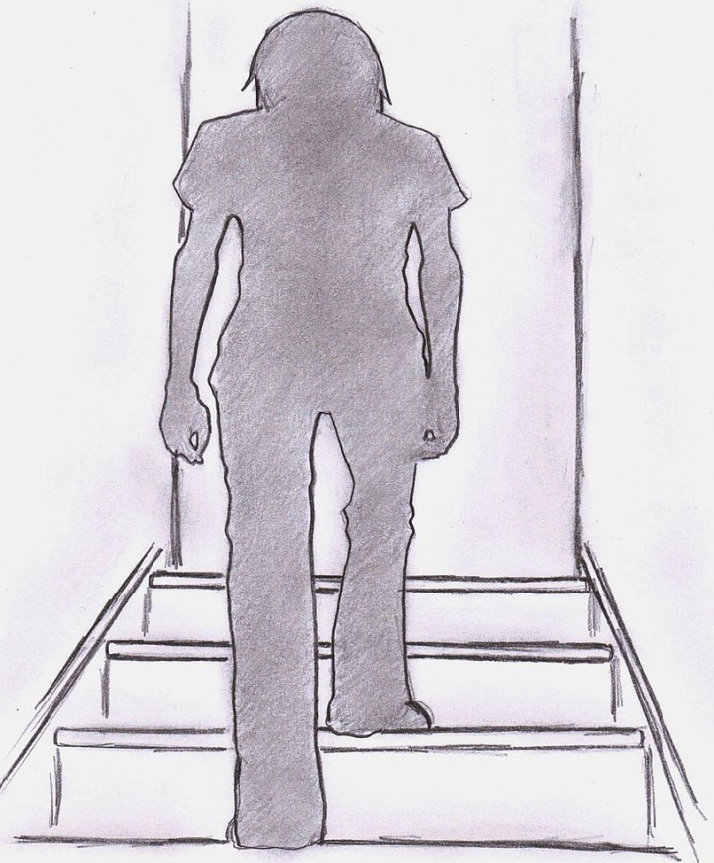
twelve step model
While still referring to “alcoholic and drug addiction” as illnesses of body and mind, Alcoholics Anonymous (AA), the prototype for 12-step programs, considered alcoholism, perhaps first and foremost, to be a “spiritual malady.”
This mutual aid society has sought to induce “psychic change” and recovery through a “spiritual program of action” as set forth in the Twelve Steps.
Spirituality is emphasized, and distinguished from religion.
The individual is encouraged to seek his or her own conception of God or a Higher Power.
www.deviantart.com

Slide 13
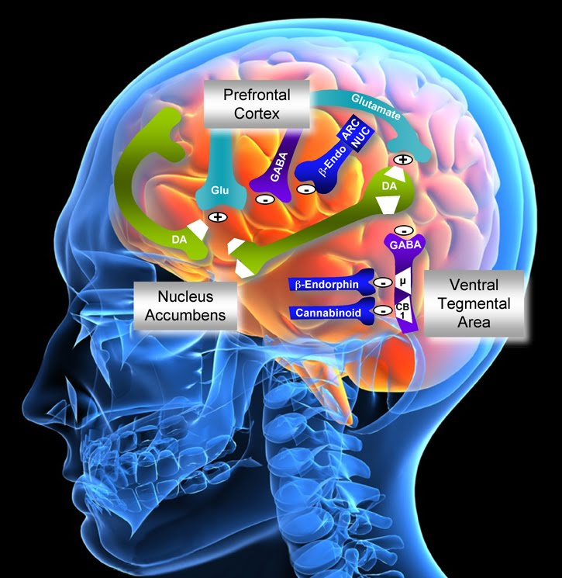
disease model
While not without its detractors, the prevailing model for substance use disorders views addiction as a medical disease
WHO recognized alcoholism as a disease in 1950; AMA in 1956.
In 2004, the Directors of NIDA and NIAAA jointly published an article that described addiction as a “disease of the brain,” with genetic, developmental, biological, and environmental influences that together “undermine voluntary control.”
One element that may be missing from these medical models is that of spirituality
http://alcoholanddrugabuse.org

Slide 14
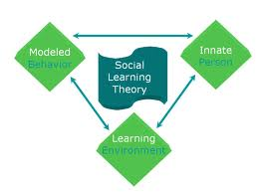
behavioral model
aligned with social learning theory
views addictions as habits overlearned through observation, interactions with the environment, and the development of faulty cognitions, associations, and reinforcement
just as undesirable habits can be learned, they can also be examined, challenged, and changed
treatment modalities that coincide with behavioral approaches include, but are not limited to
behavioral couples therapy
cognitive behavioral therapy (CBT)
relapse prevention

Slide 15
self-medication hypothesis
Dr. Edward Khantzian, Harvard psychiatrist
Derived primarily from clinical observations
substances relieve psychological suffering
preference for particular drug involves psychopharmacological specificity
includes sub-clinical conditions
“not intended to substitute for sociocultural and biogenetic theories”

Slide 16
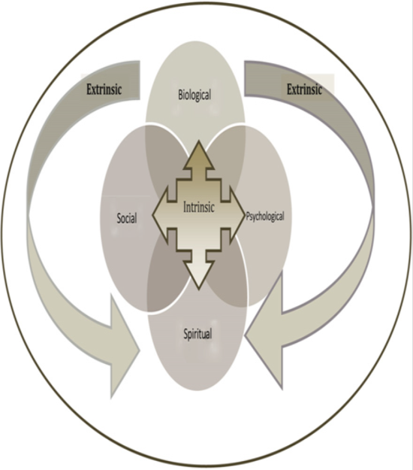
bio-psycho-social-spiritual model
may best reflect a holistic approach
has the capacity to synthesize elements from several complementary models
In her text on spirituality in nursing, O’Brien stated, “Spiritual care cannot be separated from physical, social, and psychological care.”
From Addressing Substance Use, “… a bio-psycho-social-spiritual model may be seen as the most inclusive and adaptive approach…to employ in the assessment, diagnosis, and treatment of patients across a broad continuum of substance use, including addiction and recovery.”
(Matteliano et al., 2012)

Slide 17
definition of addiction
American Society of Addiction Medicine (ASAM, 2011):
Addiction is a primary, chronic disease of brain reward, motivation, memory and related circuitry. Dysfunction in these circuits leads to characteristic biological, psychological, social and spiritual manifestations. This is reflected in an individually pathologically pursuing reward and/or relief by substance use and other behaviors…Addiction is characterized by inability to consistently abstain, impairment in behavioral control, craving, diminished recognition of significant problems with one’s behaviors and interpersonal relationships, and a dysfunction of emotional response. Like other chronic diseases, addiction often involves cycles of relapse and remission. Without treatment or engagement in recovery activities, addiction is progressive and can result in disability or premature death.

Slide 18
tobacco use
Single greatest cause of preventable morbidity and mortality in the United States
> 440,000 premature deaths annually
Includes 49,000 from exposure to secondhand smoke
Despite significant reductions during past 5 decades, 19.0% of adults were current smokers in 2011
Rates higher among men (22%), those below poverty level (29%), American Indians and Alaskan Natives (32%), those with GED (45%)
Ranks continue to be filled by youth
Tobacco use termed pediatric epidemic
Each day 4,000 under age 18 smoke first cigarettes
Among high school seniors, 1 in 4 a regular cigarette smoker, and 80% of these will continue to smoke into adulthood
1 in 5 white adolescent males (aged 12-17) uses smokeless tobacco
Smoking rates during pregnancy among women ages 15-44: 22% among whites, 14% among blacks, 7% among Hispanics
Smoking during pregnancy associated with spontaneous abortions, stillbirth, preterm birth, fetal growth restriction
Although most women may cease smoking during pregnancy, many relapse following delivery
Children exposed to secondhand smoke more likely to suffer from ear infections, asthma, other respiratory illnesses

Slide 19
alcohol use
Third leading cause of preventable death in US (85,000) after tobacco, and combination of poor diet and inactivity
In one epidemiological study, lifetime prevalence of any alcohol use disorder was 30%
In another study, risky or hazardous alcohol use (>NIAAA guidelines, Box 3) in past month was 22%
Many adults who develop alcohol use disorders establish patterns of problematic drinking during adolescence
Monitoring the Future (MTF) 2011
70% of high school seniors reported lifetime use
51% drunk at least once
22% binge drinking (defined as > 5 drinks in a row) during last 2 weeks
“Extreme binge drinking,” high school seniors 2005—2011
20% > 5 drinks in a row
11% > 10 drinks in a row
6% > 15 drink in a now, in the past 2 weeks
Binge drinkers more likely to be male, more days of skipping school, perceiving that more friends got drunk, spending more evenings out with friends, use of cigarettes or marijuana during last month.

Slide 20
cannabis use
Cannabis use continues to increase among residents in U.S. ages 12 and older
Remains most widely used illicit substance among youth
Monitoring the Future (MTF) 2012, high school seniors
36% had used during past year
23% during past month
7% daily users
One explanation for increased use is corresponding decrease in perceived risk
Contrary to this perception, systematic review in Lancet linked early cannabis use to increased risk for psychosis later in life.
Continued controversy
Federal law classifies cannabis as Schedule I
Local and state referenda have produced an inconsistent patchwork of varied legislative and law-enforcement efforts.
Some call for wholesale legalization
Others advocate for use of “medical marijuana”
Can create conflict for clinicians

Slide 21
nonmedical use of prescription medications
Nonmedical use defined
Taking a medication prescribed for somebody else
Taking a drug in a higher quantity or in a manner other than prescribed
Taking a drug for another purpose than prescribed
This category includes prescription stimulants, as well as sedatives, hypnotics, or anxiolytics. Most attention, thus far, has focused on misuse of prescription opioid medications.
Nonmedical use of prescription pain relievers 14%, or 35 million people, ages 12 and older
majority obtained for free from a friend or relative
highest rates among young adults, ages 18-25

Slide 22
prescribing and use
Dramatic increases in prescribing and nonmedical use of opioid pain relievers across the lifespan.
From 1997 to 2007, milligram-per-person use of prescription opioids escalated from 79 to 369 mg, an increase of 402%.
From 2000 to 2009, number of prescriptions dispensed by retail pharmacies increased from 174 million to 257 million, or 48%.
Approximately 20% of all prescribers responsible for 80% of prescriptions written for opioid pain relievers.

Slide 23
overdoses and death
In 2011, more than 420,00 emergency department visits involved nonmedical use of opioid analgesics.
In 2008, opioid pain relievers involved in 14,800 deaths, or nearly three-quarters (74%) of all overdose deaths involving prescription drugs.
While men remain more likely to die from drug overdoses, an alarming increase in opioid overdose deaths among women.
Between 1999 and 2010, nearly 48,000 women died of such overdoses, an increase of more than 500% in a 12-year period.
Women at greatest risk were those 45 to 54 years, non-Hispanic whites, American Indians, and Alaskan Natives.

Slide 24
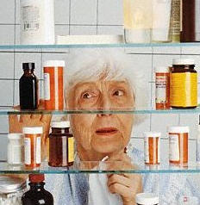
opioids, pregnant women, infants, and the elderly
Among pregnant women, opioid use disorders also place infants at risk.
Between 2000 and 2009, the number of neonates who suffered neonatal abstinence syndrome (NAS) increased by 300%.
With the aging baby-boomer generation, it is estimated that nonmedical use of prescription medications will increase dramatically among older adults [also cannabis, binge drinking].
With increased age, reduced physiological capacity to metabolize medications places seniors at greater risk for injuries and potentially fatal drug-drug interactions including, most notably, combinations of central nervous system depressants.

Slide 25
what’s wrong with the status quo?
Of 2.5 million patients with substance use disorders who are admitted to hospitals, fewer than half are asked about substance use.
Of 1.5 million patients admitted for trauma caused by risky substance use, fewer than 1 in 20 (5%) have any medical notation that substance use was assessed.
Clinicians receive little training about substance use assessment or treatment, during or after formal education
are not trained in brief interventions
are not aware of community resources
If today, The Joint Commission (TJC) were to mandate the nation’s 5,012 hospitals to routinely screen and treat substance use problems, few would be able to comply.
“Clinician suspicion” is notoriously inaccurate when trying to predict those with substance use and related disorders.

Slide 26
USPSTF is an independent panel of nonfederal experts in prevention and evidence-based medicine, composed of primary care clinicians.
Conducts scientific reviews of a broad range of clinical preventive health care services, and develops recommendations for primary care clinicians and health systems.
Recommendations based and graded on current available evidence.
Suggested that clinicians offer or provide services that receive a letter grade of A or B
Grade A: High certainty that the net benefit is substantial
Grade B: High certainly that the net benefit is moderate, or moderate certainty that the net benefit is moderate to substantial

Slide 27
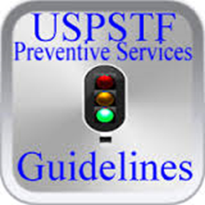
Box 4: USPSTF recommendations pertaining to substance use and related disorders
Tobacco
Primary care clinicians provide interventions, including education and brief counseling, to prevent initiation of tobacco use in school-aged children and adolescents (Grade B).
Clinicians ask all adults about tobacco use and provide tobacco cessation interventions for those who use tobacco products (Grade A).
Clinicians ask all pregnant women about tobacco use and provide augmented, pregnancy-tailored counseling for those who smoke (Grade A).
Alcohol
Clinicians screen adults aged 18 years or older for alcohol misuse, and provide persons engaged in risky or hazardous drinking with brief behavioral counseling interventions to reduce alcohol misuse (Grade B).
Screening for Hepatitis C Virus Infection in Adults
Screening for hepatitis C virus (HCV) infections in persons at high risk for infection (Grade B). Note: “The most important risk factor for HCV infection is past or current injection drug use.”

Slide 28
USPSTF “I Statements”
In addition to graded recommendations, the USPSTF may also issue an I Statement, indicating that current evidence is insufficient to formulate recommendations either for or against particular service.
Indicates that evidence is lacking, of poor quality, or conflicting, and that additional research is needed to formulate a recommendation.
Current I Statements issued for
Screening and behavioral counseling interventions in primary care settings to reduce alcohol misuse in adolescents
Screening adolescents, adults, and pregnant women for illicit drug use

Slide 29
other recommendations
Recommendations from the American Academy of Family Physicians (AAFP) mirror those of the USPSTF.
Other professional organizations have issued additional recommendations regarding prevention and screening.
American Academy of Pediatrics (AAP) recommends that pediatricians
Incorporate substance use prevention into daily practice
Acquire necessary skills to identify young people at risk for substance use
Provide or facilitate assessment, intervention, and treatment as necessary
American College of Obstetrics and Gynecology (ACOG) recommends direct questioning by clinicians of all patients about their use of drugs (in addition to tobacco and alcohol) as part of periodic assessment.
The American Lung Association (ALA) Lung Cancer Screening Committee has issued interim recommendations for low-dose computed tomography screening for lung cancer among current smokers aged 55 to 74 with a smoking history of at least 30 pack-years and no history of lung cancer.

Slide 30
historic perspective
Historically, alcohol, tobacco, and other substance use disorders were treated almost exclusively from a tertiary care perspective.
More recently…the focus has begun to shift more toward prevention and early intervention.
This includes Screening, Brief Intervention, and Referral to Treatment (SBIRT)

Slide 31
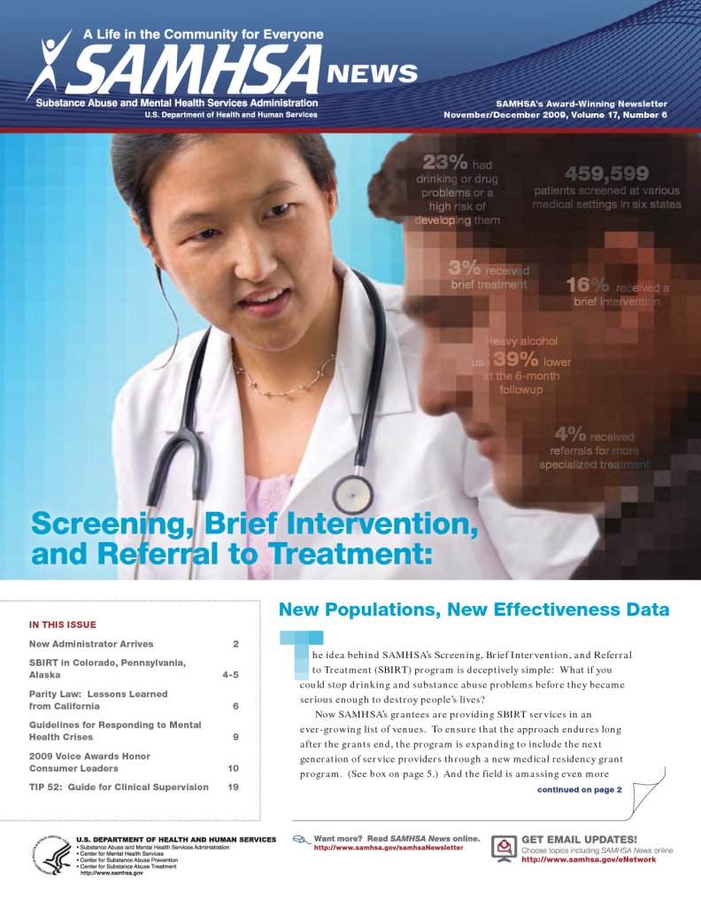
SBIRT: Screening, Brief Intervention and Referral to Treatment
Per SAMHSA, “SBIRT is a comprehensive, integrated public health approach to the delivery of early intervention and treatment services for people with substance use disorders, as well as those who are at risk of developing these disorders. Primary care centers, hospital emergency rooms, trauma centers, office-based practices and other community settings provide opportunities for early intervention with at-risk substance users before more serious consequences occur.”

Slide 32
universal screening
The first step of SBIRT is implementation of universal screening to help identify patients who may be at risk for, or are currently experiencing, problematic substance use.
Many primary care clinicians ask about cigarette smoking and other tobacco use, but fewer inquire about alcohol and other substance use.
Screening negative, in the absence of any evidence to the contrary, indicates that screening is complete. This affords the clinician an opportunity to provide positive verbal reinforcement for healthy behaviors related to substance use.
It is generally recommended that screening be repeated on a routine basis at least annually, or earlier as changes in behavior, health status, or other personal circumstances warrant.

Slide 33
Box 6 One-item and 2-item screening tests for alcohol and/or other drug misuse
Single-question screening test for unhealthy alcohol use Question: “How many times in the past year have you had X or more drinks in a day” (where X is 5 for men and 4 for women) Response: A response of > 1 is positive Sensitivity 82%, specificity 79%
Single-question screening test for drug use Question: “How many times in the past year have you used an illegal drug or used a prescription medication for nonmedical reasons?” Response: A response of > 1 is positive Sensitivity 100%, specificity 73.5%
Two-item conjoint screen for alcohol and other drug problems Questions: “In the past year, have you ever drunk or used drugs more than you meant to?” “Have you felt you wanted or needed to cut down on your drinking or drug use in the last year?” Response: A response of > 1 is positive for a current substance use disorder Sensitivity 79%, specificity 78%

Slide 34
Table 3 Selected screening instruments for tobacco, alcohol, and/or other substance use
Substance | Instrument | Target Population | Description
Tobacco | Fagerstrom Test for Nicotine Dependence (FTND) | Adults | 6-item screen measuring intensity of physical addiction to nicotine (cigarettes); level of severity assists in treatment planning
Alcohol | Youth Guide | Children, Adolescents | 2-item screening tool for students in elementary school (aged 9-11 y), middle school (aged 11-14 y), and high school (aged 14-18 y); identifies risk factors for alcohol use.
 | Alcohol Use Disorders Identification Test (AUDIT) | Adults | 10-item screening tool, developed by the World Health Organization, to identify risky or hazardous alcohol use
 | AUDIT-C (Consumption) | Adults | First 3 questions of AUDIT, focusing on alcohol consumption
 | TWEAK (Tolerance, Worried, Eye-Opener, Amnesia, K/cut down) | Adults, Pregnant Women | 5-item screening tool for risky drinking, with questions related to tolerance, worried, eye-opener, amnesia, and attempts to k/cut down
Alcohol and other drugs | CRAFFT (Car, Relax, Alone, Forget, Family or Friends, Trouble) | Adolescents | 6-item screening tool for alcohol and other drugs; targets situations relevant to adolescents: Car, Relax, Alone, Forget, Family or Friends, Trouble
Other drugs | Drug Abuse Screening Test-20 (DAST-20) | Adolescents, Adults | 20-items screening tool to detect consequences related to drug use; includes prescribed or over-the-counter drugs, and any nonmedical use of drugs

Slide 35
Table 2 AUDIT-C questionnaire
Scoring | 0 | 1 | 2 | 3 | 4 |  | Score
Questions
How often do you have a drink containing alcohol? | Never | Monthly or less | 2 to 4 times a month | 2 to 3 times a week | 4 or more times a week
If score to first question is zero, stop screening here.
How many drinks containing alcohol do you have on a typical day when you are drinking? | 1 to 2 drinks | 3 to 4 drinks | 5 to 6 drinks | 7 to 9 drinks |  | 10 or more drinks
How often do you have 5 or more drinks on one occasion? | Monthly | Less than monthly | Monthly | Weekly |  | Daily or almost daily
Total score
The AUDIT-C is scored on a scale of 0-12 (scores of 0 reflect no alcohol use). In men, a score of 4 or more is considered positive; in women, a score of 3 or more is considered positive. In general, the higher the AUDIT-C score, the more likely it is that the patient’s drinking is affecting his or her health and safety. Babor et al., 2011.

Slide 36
contents of a standard alcoholic drink
One 12 ounce can of beer
A “shot” (1.5 oz.) of spirits,
or hard liquor (80 proof)
A 5 ounce glass of wine
A small glass of sherry, liqueur, or apertif (4 oz.)

Slide 37
other alcoholic beverage drink conversions
Beverage | Amount | # SD
Wine | 750 ml. 1 liter | 5 6
Liquor | pint fifth quart half gallon | 11 17 21 42

Slide 38
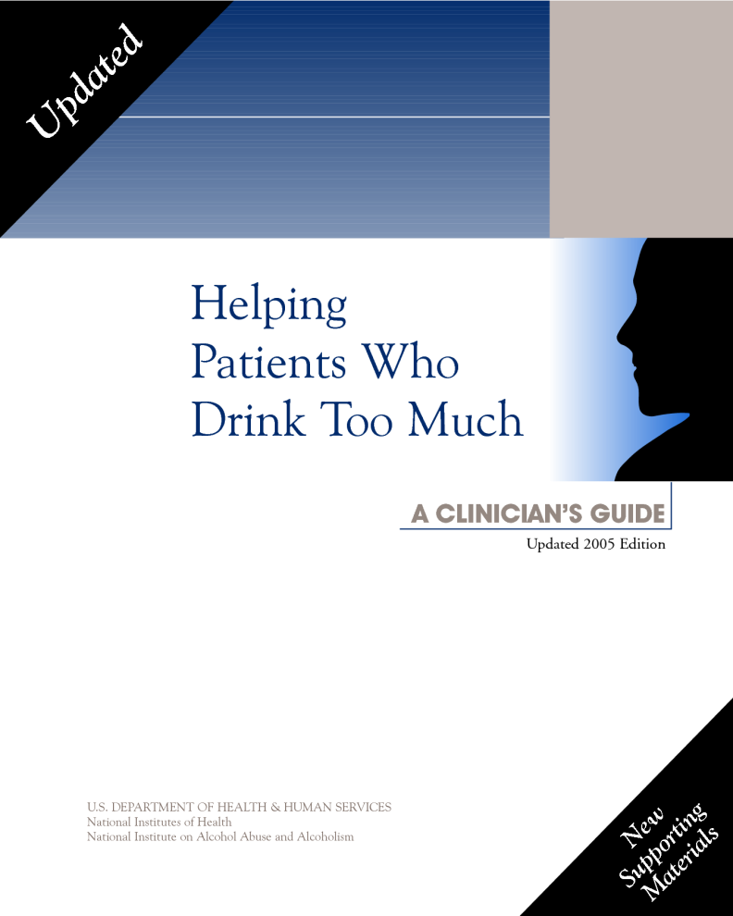
NIAAA Clinician’s Guide
begin with a neutral lead-in question
ask about frequency
quantity (standard drinks) *
greatest number in past week/month/year
compare to guidelines
provide positive reinforcement and encouragement if within guidelines
recommend changes if exceeding these
reduction
trial abstinence period
referral to treatment

Slide 39
brief intervention
Brief intervention is the cornerstone of SBIRT, based on the Transtheoretical Stages of Change, and Motivational Interviewing (MI). *
The object is to help patients move along a continuum of cognitive and behavioral health.
Progress is seldom linear, and setbacks may occur.
Brief interventions are short (5-15 minutes) semi-structured discussions intended to raise awareness and increase motivation to avoid, reduce, or discontinue potentially problematic use of alcohol or other substances.
Six elements critical brief interventions are captured in the acronym FRAMES.

Slide 40
Transtheoretical Stages of Change Model ( Prochaska and DiClemente )
Precontemplation
Contemplation
Wheel of Change
Preparation
Relapse
Action
Termination
Maintenance

Slide 41
FRAMES
Feedback is given to the individual about personal risk or impairment.
Responsibility for change is placed on the patient.
Advice to change is given by the provider.
Menu of options is offered for behavioral change, supports, and/or treatment options.
Empathic style is used in counseling.
Self-efficacy or optimistic empowerment is engendered in the patient.

Slide 42
how many sessions?
The number of sessions for screening and brief intervention may vary based on several factors
Patient’s level of risk or severity related to substance use
Current medical conditions and/or other complicating factors
His or her response to screening and brief intervention
“Medicare covers annual alcohol misuse screening and, for those who screen positive, up to 4 brief face-to-face behavioral interventions in a 12-month period…for Medicare beneficiaries, including pregnant women.”
Some SBIRT models describe brief treatment as an intermediate step between brief intervention and referral to treatment. This may involve more intensive counseling sessions, delivered by clinicians with additional qualifications or experience in counseling, addictions medicine, addictions nursing, or other addictions specialist. The level of intervention should match the potential risk or severity of use (Figure 2).

Slide 43
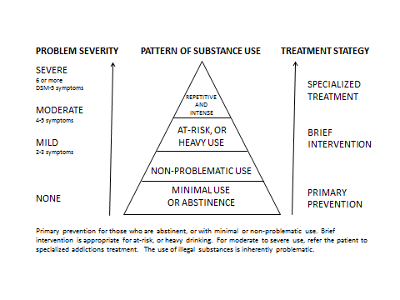
Figure 2.
From Strobbe, S. (2013). Addressing substance use in primary care. Nurse Practitioner, 38(10), 45-54.

Slide 44
Table 1 The 5 As of behavioral counseling
Assess | Ask about/assess behavioral risk(s) and factors affecting choice of behavior change goals/methods
Advise | Give clear, specific, and personalized behavior-change advise, including information about personal health harms and benefits
Agree | Collaboratively select appropriate treatment goals and methods based on the patient’s interest in and willingness to change behavior
Assist | Using behavior-change techniques (self-help and/or counseling), aid the patient in achieving agreed-upon goals by acquiring the skills, confidence, and social/environmental supports for behavior change, supplemented with adjunctive medical treatments when appropriate
Arrange | Schedule follow-up contacts (in person or by telephone) to provide ongoing assistance/support and to adjust the treatment plan as needed, including referral to more intensive or specialized treatment

Slide 45
referral to treatment
Patients needing more help than brief interventions are referred to specialty treatment.
In preparation for this eventuality, primary care clinicians encouraged to identify, establish, and maintain collaborative relationships with clinicians and facilities that provide addictions treatment.
SAMHSA Substance Abuse Treatment Locator lists all state-licensed treatment facilities throughout the United States www.findtreatment.samhsa.gov
Because most treatment for substance use disorders occurs on an outpatient basis, the primary care clinician will likely continue to provide routine medical care while the patient participates in treatment, and after discharge.
This provides a unique opportunity to create a culture of collaboration between primary care clinicians and addictions treatment services, and to provide true continuity of care.

Slide 46
other considerations: mutual help groups
An essential part of treatment and recovery for many individuals with substance use disorders.
Alcoholics Anonymous (www.aa.org)
Women For Sobriety (www.womenforsobriety.org)
Narcotics Anonymous (www.na.org)
SMART Recovery (www.smartrecovery.org)
Al-Anon and Alateen
(www.al-anon.alateen.org)
Nar-Anon (www.nar-anon.org)
Health care professionals are encouraged to familiarize themselves with these potentially life-saving societies by attending one or more open meetings, i.e., meetings open to the general public.

Slide 47
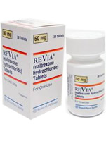
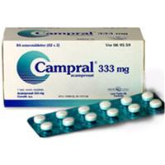
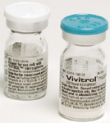
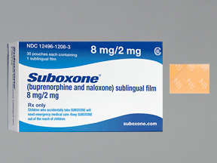
medications for addictions
Tobacco
Nicotine replacement therapy
Nicotine gum
Nicotine lozenges
Nicotine nasal spray
Nicotine transdermal patches
Nicotine inhalers
Medications
Bupropion (Zyban)
Varenicline (Chantix)
Alcohol
Acamprosate (Campral)
Disulfiram (Antabuse)
Naltrexone
Oral (ReVia)
Injectable (Vivitrol)
Opioids
Antagonist therapy
Naltrexone
Oral (ReVia)
Injectable (Vivitrol)
Replacement/maintenance therapy
Buprenorphine (Suboxone, Subutex)
Methadone

Slide 48
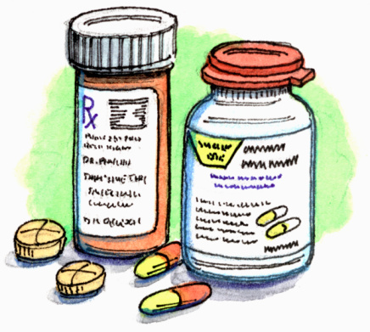
other medications
Avoid the use of agents that might place patients at increased risk for misuse or relapse, particularly benzodiazepines or opioid medications.
For specific procedures that require these agents, review associated risks with the patient
If concern regarding the possibility of multiple prescribers, or “doctor shopping,” the check your state’s prescription drug monitoring program (PDMPs).
More information can be found through accessing the web site of the US Department of Justice Drug Enforcement Administration’s Office of Diversion Control
(http://www.deadiversion.usdoj.gov/faq/rx_monitor.htm)

Slide 49
pain management
In 2012, the National Institute on Drug Abuse (NIDA) and the Office of National Drug Control Policy (ONDCP) launched a new online tool to provide training to health care professionals on proper prescribing and patient management practices for patients receiving opioid analgesics.
Continuing Medical Education/Continuing Education (CME/CE) credits are available when accessed through Medscape.
Safe Prescribing for Pain CME/CE
Managing Pain Patients Who Abuse Prescription Drugs
Oliver, Coggins, Compton, Hagan, Matteliano, Stanton, St. Marie, Strobbe & Turner (2012). American Society for Pain Management Nursing position statement: Pain management in patients with substance use disorders. Pain Management Nursing, 13 (3), 169-183
Provides universal precautions and clinical recommendations for patients with low, moderate and high risk of substance use.
Ethical tenets discussed, and adherence monitoring procedures are also considered, including urine toxicology studies.

Slide 50
current practice
Despite compelling evidence that prevention and SBIRT can be efficacious and cost-effective in addressing substance use and related disorders, primary care clinicians slow to adopt these practices.
Alcohol problems, in particular, or commonly not identified during routine health care services.
National sample, individuals 18 to 39 years
Slightly fewer than half (49%) of those who had seen a doctor in the past year recalled having been asked about their alcohol consumption.
Among those who exceed NIAAA guidelines for per-day or per-week limits, only 14% recalled having been advised about these limits
Fewer still (7%) were advised to cut down.
Proportions slightly higher among those who exceeded both daily and weekly limits
24% advised about safe limits
21% advised to cut down

Slide 51
barriers to delivery
Commonly identified barriers for implementing screening and preventive services
Concern that tools do not reflect realities of practice, e.g., time, demographics
Worry that screening will identify patients whose needs exceed available resources
Clinician lacks requisite expertise
Lack of comfort in asking patients about alcohol use
Inadequate reimbursement
Certain of these concerns can be addressed in the context of SBIRT
Reimbursement now available
Current Procedural Terminology (CPT) codes
Medicare G codes
Medicaid Healthcare Common Procedure Coding System (HCPCS) codes
January 1, 2010, Mental Health Parity and Addiction Equity Act of 2008 went into effect

Slide 52
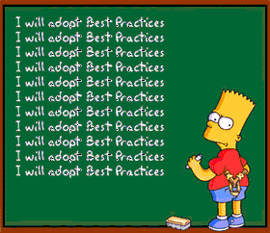
characteristics of organizations that facilitate best practice
Researchers examined Chronic Care Model as a framework for the prevention of risk behaviors, including tobacco use and risky drinking.
Primary care practices more likely to offer recommended services such as health risk assessment, behavioral counseling, referral to community-based programs if
Owned by a hospital health system that exhibited culture of quality improvement
Had a multispecialty staff
Received support for decision-making through point-of-care reminders and clinical staff meetings
Benefited from information systems such as electronic health record (EHR)

Slide 53
team-based approach
Team-based approach may help to improve screening and services in primary care practice
Capitalizes on strengths of each team member
Other team members can complete some tasks, enabling clinicians to attend to patients with highest severity
Nurses, social workers, medical assistants can administer screening instruments, provide education, answer questions, triage patients with positive screen
Clinician or dedicated SBIRT provider can carry out SBIRT
Leaders can champion SBIRT by establishing culture that takes substance misuse seriously, and support staff and clinician training in SBIRT methods.
Because team-based models for SBIRT on cutting edge of care, insufficient data to assess efficacy, but emerging evidence suggests that this approach shows promise.

Slide 54
impact of changes within health care
Some potential benefits of EHR in prevention and treatment of substance use disorders
Single, comprehensive medical record, available across sites, providers, and services
Creation of mandatory fields for information related to tobacco, alcohol, and other substance use
Ready access to patient-specific educational materials
Potential to generate automated charges for services, such as prevention, screening, and brief intervention
Prompts for follow-up during subsequent visits
Ability to track and graph laboratory values and other clinical activities
Improved monitoring of prescription medications, including controlled substances

Slide 55
Affordable Care Act
The Affordable Care Act (ACA) promises to enhance and expand efforts toward prevention and treatment of substance use disorders.
Requires most health insurance plans to cover preventive services recommended by USPSTF
Per ONDCP, “…includes substance use disorders as one of the ten elements of essential benefits,” meaning “more health care providers can offer and be reimbursed for these services, resulting in more individuals having access to these services.”
Benefits for substance use disorders now more closely aligned with those for other chronic health conditions, with prospects for more continual, rather than episodic, care.

Slide 56
Patient-Centered Medical Homes (PCMH)
Described as a transformative model for primary care
Encompasses 5 functions and attributes
Comprehensive care
Patient-centered care
Coordinated care
Accessible services
Quality and safety
Noteworthy that these are many of the same holistic values that have defined quality addictions treatment for decades.
Elements of the Minnesota Model, the prevailing approach to abstinent-based 12-step treatment and recovery
Individualized treatment plans with active family involvement
Interprofessional collaborative team focused on comprehensive care
Integrated health with mind, body, and spirit
The prospect of a true partnership with the medical community in the form of PCMHs bodes well for treatment and recovery from addictive disorders.

Slide 57
summary
Alcohol and other substance use disorders are a major public health concern, contributing to increased health care costs and needless human suffering.
SBIRT can help to reduce these burdens by improving the health and well-being of individuals, families, and communities.
Primary care clinicians, including physicians, physician assistants, and nurse practitioners, are on the leading edge of transformative changes in the health care system, including unprecedented access to alcohol and substance use screening and care.
Although full benefits of ACA and the Mental Health Parity and Addiction Equity Act have yet to be realized, the outlook for a more humane, effective, and holistic future for alcohol and substance use prevention, screening, and treatment is hopeful.

Slide 58
questions, answers, discussion

