Slide 1
Opiates: The Big Picture
Barry T. Schmidt, MPH, MS, CPC-R
Neighborhood Resource Center Project Director and Coalition Coordinator

Slide 2
The Big Picture
Demonstrate the connection between Youth and Older Adult use of opiates.
Provide Local Youth data
Older Adults National Data

Slide 3
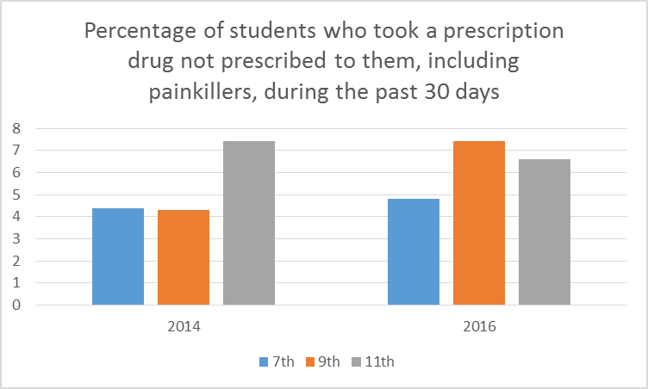
Youth
Notes:
According to the Michigan Profile for healthy Youth 7th grade students have increased in the percentage of students who have taken a prescription drugs in 30 day use. Additionally, ninth grade students has also increased.
Some good news is that in that same survey the percentage of 11th grade students who took a prescription drug not prescribed to them have decreased. This may demonstrate that youth are using at younger ages, but with increased media exposure of the effects of the disease on them and their families, education and thinking and believing in their future are less likely to continue their use in 11th .

Slide 4
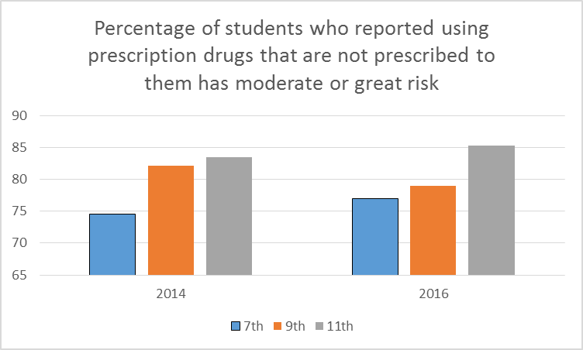
Youth
Notes:
However, as we see in this same slide from the same Mi-Phy survey it appears 7^{th and} 11th graders have increased their perception of risk, but ninth grade students still seem to see a lower risk from 2014 to 2016.

Slide 5
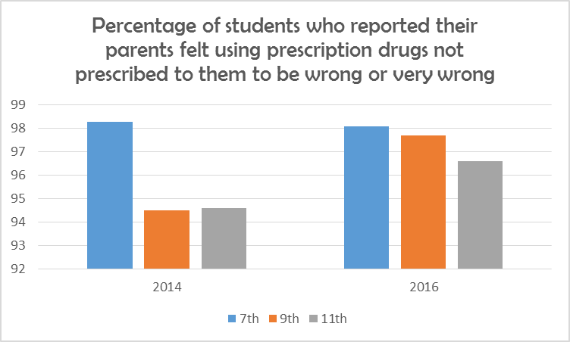
Youth
Notes:
When youth were asked about their parents disapproval of risk seventh grade decreased, however those same students in 2016 as ninth grader increased and the ninth graders (2014) because 11th graders in 2016, which may have been to the plethora of media coverage and community action, where parents began to see the connection between prescription drugs and heroin.

Slide 6
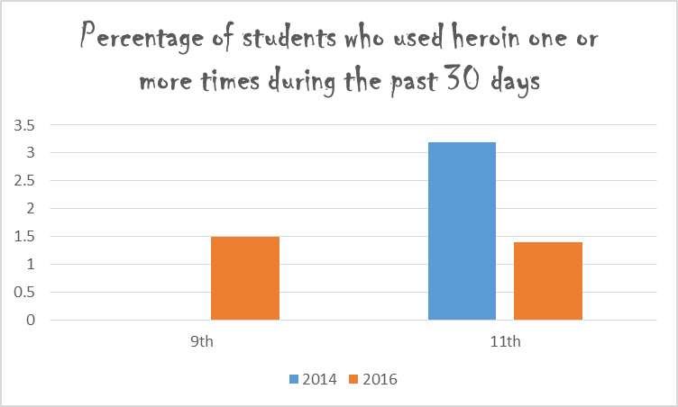
Notes:
Finally, the use of heroin appeared to reach over 3% for 11th graders, but decreased to just under 1.5% an almost 50% decrease which demonstrates the effective of our community seeing the problem and people willing to action is noticed by the yoouth/.

Slide 7
Older Adults Take More Medicine
Consume 1/3 of all prescription meds
One in four older adults has used psychoactive meds with abuse potential
Prescription drug misuse and abuse
is a growing problem
May be as high as 11% of older adult population
Notes:
According to US Census data and currently 13% of the U.S, Population is comprised of Older Adults and that is expected to rise to 20% by 2030.
Those 85 and Older are the fastest growing segment of the population.
What percentage of older adults use psychoactive medication with abuse potential? Is it 10%, 25%, 50% or 75%. According to the SAMSHA Approximately 25 percent of older adults use prescription psychoactive medications that have a potential to be misused and abused.
Teaching Points:
Although illicit drug use is relatively rare among older adults compared to younger adults and adolescents, there is increasing evidence that prescription drug misuse and abuse is a growing problem in the older population (Simoni-Wastila and Yang, 2006).
Older adults are particularly vulnerable to misuse and abuse of prescription medications. Persons ages 65 and older make up less than 15 percent of the population but they consume about one-third of all prescription medications (CDC & Merck, 2004) and take more potentially addictive medications than any other age group (Blow, 2003). The prevalence of prescription drug abuse may be as high as 11% (Simoni-Wastila & Yang, 2006). One in four older adults has used psychoactive medications with abuse potential, and such use is likely to grow as the population ages (Simoni-Wastila & Yang, 2006).

Slide 8
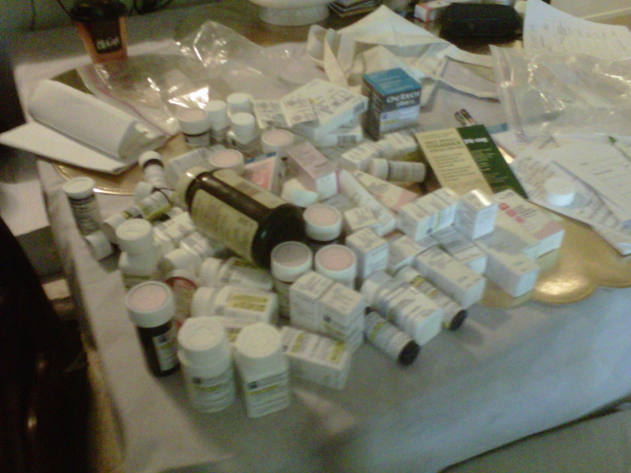
How Many is Too Many?
Notes:
Speaker Tip:
This photo illustrates excessive medications in a patient’s home. If you have a photo from your own practice, you should use it to illustrate the problems that are present in some community-based patient homes regarding medication management, which is a product of and contributes to prescription drug misuse and abuse.

Slide 9
Older Americans hooked on Rx: 'I was a zombie'
http://www.usatoday.com/story/news/nation/2014/05/20/seniors-addiction-prescription-drugs-painkillers/9277489/

Slide 10
Prescription Drug Abuse Older Adults
Drug misuse and abuse is present in 11% of older adults
Second only to alcohol abuse
ED visits doubled between 2004 & 2008
20% age 70 and older
1/3 required hospitalization
Projected to reach 88.5 million in 2050 (Alliance for Aging Research, 2006)
4.4 million will need substance abuse treatment
Notes:
Teaching Points:
The combination of prescription drug misuse and abuse—the intentional taking of prescription drugs that are not medically necessary—is present in 11% of elderly individuals (Simoni-Wastila et al., 2006).
Data from the National Survey on Drug Use and Health indicate that nonmedical use of prescription medications is second only to alcohol abuse among adults older than 55 (SAMHSA NDSUH, 2011).
Emergency department (ED) visits involving drug misuse and abuse by adults aged 50 or older more than doubled between 2004 and 2008 (SAMHSA, 2010).
One-fifth of ED visits were made by persons aged 70 or older.
More than one-third of ED visits made by older adults misusing or abusing pharmaceuticals resulted in a hospital admission; of these, nearly a quarter resulted in an admission to the intensive care unit.
Nonmedical use of psychotherapeutic drugs among adults aged 50 years and older is projected to double over two decades, to 2.7 million by the year 2020 (Colliver et al, 2006; Han et al, 2009), with 4.4 million in need of substance abuse treatment (Gfroerer et al, 2003).
Speaker Tip:
Now is a good time to talk about the baby boomers and how THEY are making such an impact on these statistics.
Teaching Points:
The “baby boom” generation (those born between 1946 and 1964) has experimented with alcohol and illicit drugs—such as marijuana, cocaine, heroin, methamphetamine—more than any previous generation and this group may have more lenient views on prescription medications and drug use compared to prior generations. Marijuana use is more common than nonmedical use of prescription drugs among adults aged 50-59, while nonmedical use of prescription drugs is more common in those aged 60 and older (SAMHSA, 2011).

Slide 11
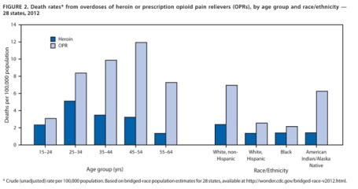
Death rates from prescription opioids
Significant increases in 45-54 and 55-64 age groups
Swallow, 2014; CDC, 2013

Slide 12
Three Legged Stool Approach
OPIATES
Law Enforcement and Courts
Bay County HOPE Taskforce
Public Health and Prevention
Treatment
Providers
baycountyhope.org
UCS
Law Enforcement/Courts
Treatment Providers
Public Health/Prevention
Notes:
10 Recommendations:
Increase collaboration within the key stakeholder partners.
Implement county-wide heroin overdose plan to save lives of our citizens.
Increase the number of providers who are implementing Screening, Brief Intervention and Referral for Treatment, so individuals receive services faster and have greater access to an addiction counselor or social worker.
Increase data-driven, high-impact options for treatment.
Ensure treatment on demand.
Investigate the feasibility of Post-Treatment Rehabilitation Housing
Increase Medical Assisted Treatment Providers.
Increase utilization of the Michigan Automated Prescription System among providers.
Implement a comprehensive strategy to educate and inform residents, businesses, health professionals and other key stakeholders about substance addiction to help reduce fear and combat stigma.
Coordinate efforts with treatment providers and law enforcement.

Slide 13
Contact Information
Barry T. Schmidt
Project Director-Neighborhood Resource Center
Coalition Coordinator-Bay County Prevention Network
barry.Schmidt@mclaren.org
895.3510

